Slide 1


EPIC and the Future of U.S. NWP
A View From Academia
Cliff Mass
Department of Atmospheric Sciences
University of Washington

Slide 2
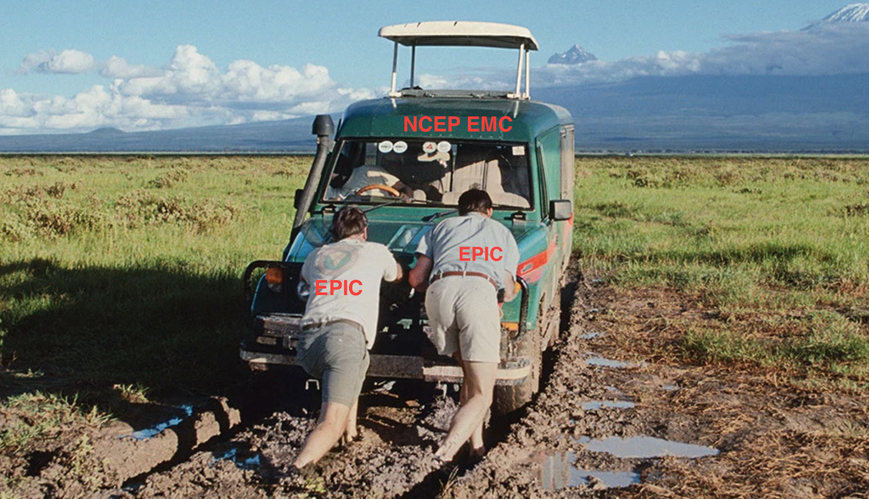
U.S. Operational Global NWP is Stuck in 2nd/3rd Place Status and Will Not Advance to First Tier Without Major Changes in Organization, Leadership, and Structure

Slide 3
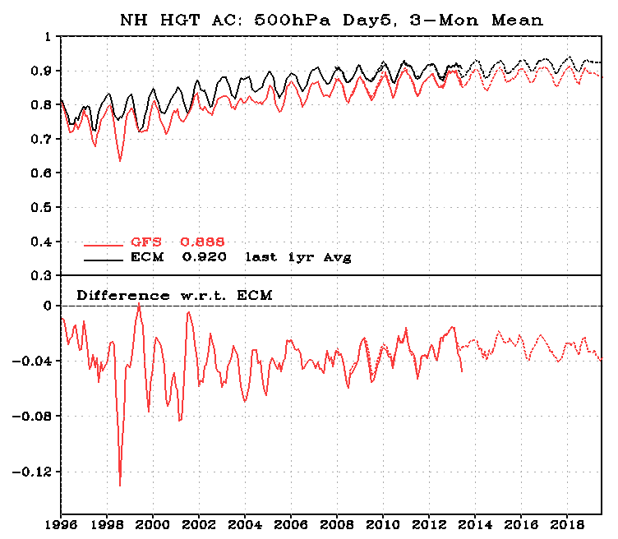
U.S. NWP Skill is Behind World Leaders and Is NOT Catching UP Even With Substantial Recent Investments

Slide 4

With the World’s Largest Atmospheric Sciences Research Community and the Largest Global NWP Budget We Should be the Best.
We are not.

Slide 5
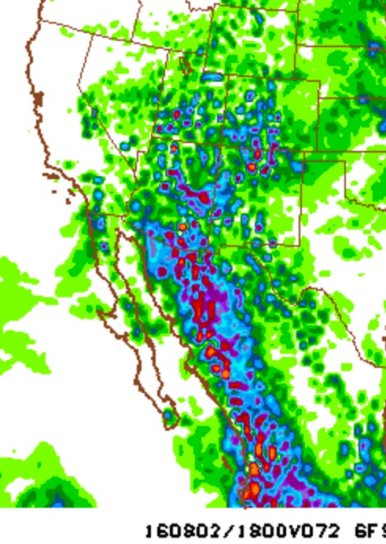
Our global model, GFS/FV-3, has lagged behind the state-of-the-science in many areas, such as:
  Cloud and precipitation microphysics
  Convective parameterization
  Resolution and size of ensembles
  Data assimilation (ECMWF moved to 4DVAR decades ago)
  Boundary layer parameterization
  Post-processing

Slide 6
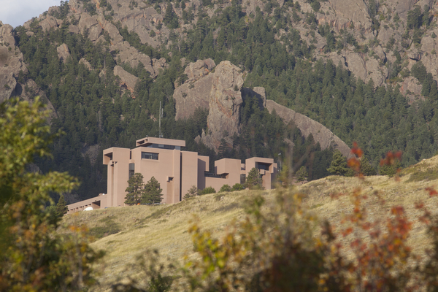

Large Impact on the Academic Community
Few academic researchers use the U.S. operational global model for research
U.S. students become familiar with and contribute to other modeling systems (e.g., WRF, MPAS, CCSM)
NCAR has developed global modeling systems completely independent of NOAA/NWS.
Many U.S. students see NCEP/EMC as a backwater and choose employment elsewhere

Slide 7

The Origin of the U.S. Global NWP Problem is No Secret
U.S. resources are spread over too many global modeling systems (e.g., Navy NAVGEM, NCAR MPAS, NOAA FV-3/NIM/FIM, NASA GEOS, AF UKMET-Unified)
NOAA has divided responsibility over NWP across too many groups and decision makers (EMC, NCEP, ESRL, OSTI, and more)

Slide 8

The Origin of the U.S. NWP Problem is No Secret
No coherent, detailed strategic plan
Poor use of resources (e.g., NGGPS)
NOAA not working closely with the NCAR and the academic community
No single group given the resources and responsibility to DO THIS RIGHT
Excellence is not a priority

Slide 9
The Situation Has Not Gotten Better with NGGPS and FV-3
FV-3 is a better model than GFS but…..
  FV-3 is poorly documented and without a complete GITHUB release
  Little support or documentation
  No plans to make it a real community model.
  NCEP staff have not mastered it themselves.
  Without an improved data assimilation system will hardly little improvement in forecast skill.

Slide 10

The Result are In: FV-3 Fails the Graduate Student Test

Slide 11

Responsibility
The cause is not the failure of individuals
The cause is the failure of the system and the organization of national resources.
The cause is the perceived self-interest of organizations.
An individual organization can’t fix this, only the agreement of the community to remake the system.

Slide 12

Our Community Have Been Given One LAST Chance Before NOAA Operational Global NWP Becomes Irrelevant

Slide 13


Slide 14

The Stars Are Aligned Now for Change
But if We Miss This Train, It May Never Come Again in our Lifetime

Slide 15
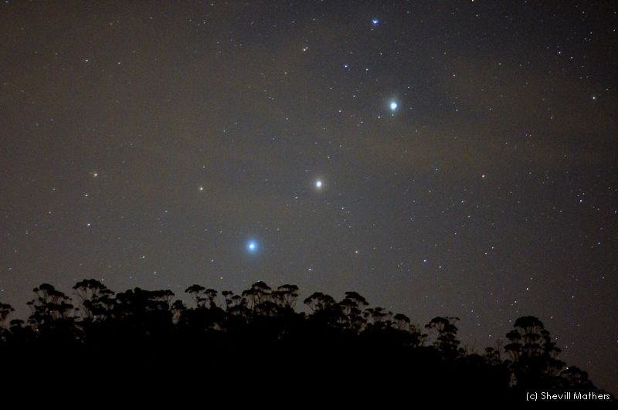
The Stars Are Aligned
NOAA leadership understands the problem and wants to fix it
Both the head of NOAA and the president’s science advisor are modelers.
The nation and Congress know the problem and are ready to invest in fixing it

Slide 16
The Stars Are Aligned
Congress passed a Weather Bill with resources and detailed guidance on how to fix U.S. NWP
Tensions between NOAA Labs and NCEP/EMC have faded.
The private sector is demanding improvement.
We are having this meeting.

Slide 17

Only by complete reorganization of how we develop, test, and improve the national global modeling system can U.S. operational NWP regain world leadership

Slide 18

Such reorganization will require more cooperation and concentration of effort

Slide 19

Isolated Fiefdoms Will Have to Be Given Up
EMC
NCAR
Navy
NASA

Slide 20

A Properly Structured EPIC Center Could Go Far in Addressing the Problem
It would be the centerpiece of NOAA and national global model development
Provide a coherent organization and leadership structure
Must include active participation of NCAR and ESRL. Hopefully, NASA and DOD
Would develop and SUPPORT a community global modeling system for all spatial scales.

Slide 21
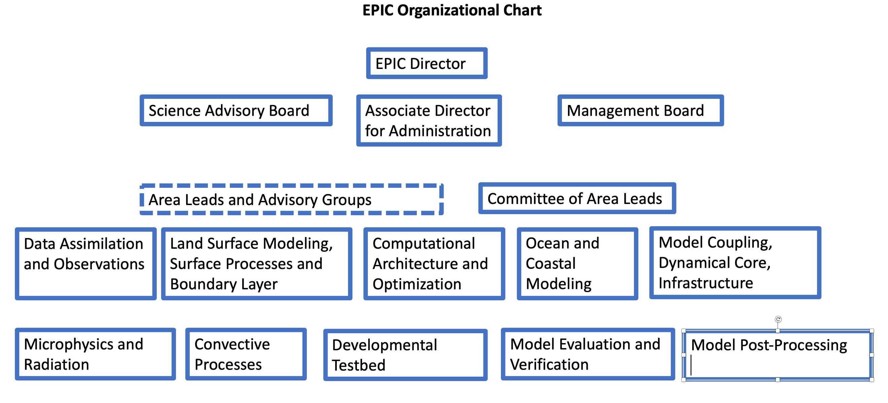
How EPIC Might Be Organized

Slide 22
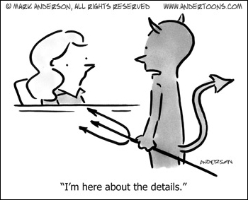
EPIC
Excellence and world leadership must be the unquestioned goals.
Must develop a national system, not a NOAA system, supporting BOTH the operational and research communities.
A comprehensive strategic plan is required as well as implementation plans.
Should be led by a well-known intellectual leader of the field and guided by an expert advisory board.

Slide 23
Even More Details
Foundational funding through NOAA; additional funding from a range of private sector and Federal sources.
EPIC should be established outside of NOAA, in a location attractive to visitors. A vibrant development center with an active seminar series and attractive visitor positions.
The new center will have the control of funds for an external grants program for research and development THAT DIRECTLY ADDRESS key needs for the new center.
The new EPIC center should contain experts that will lead efforts in each key area of global NWP.

Slide 24

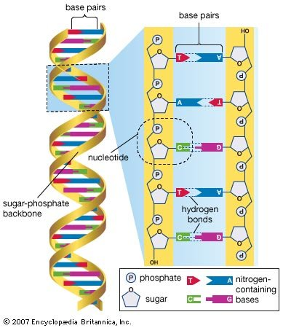
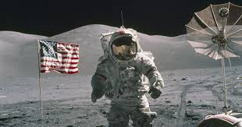
The EPIC effort will reflect some of the nation’s great science successes-- when we worked together to achieve big things

Slide 25
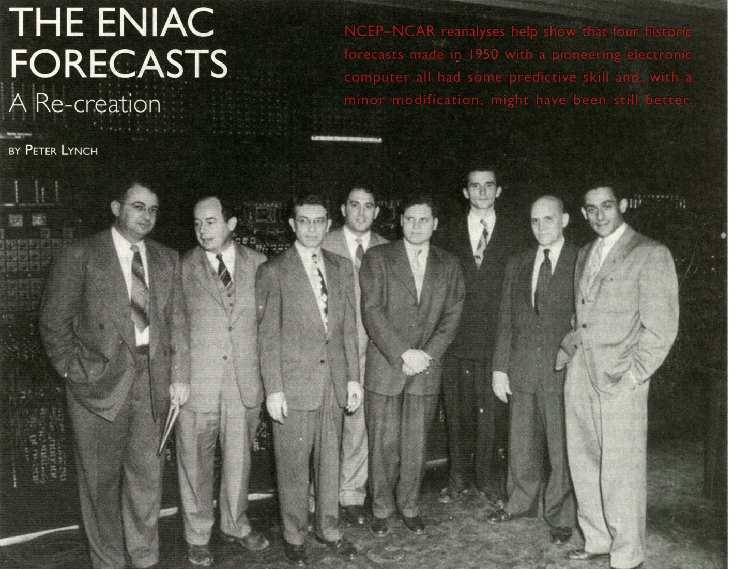
We worked together in the early decades of NWP, when the U.S. was well ahead of the rest of the world

Slide 26
We can do it again.

